Slide 1
Classification

Slide 2
How to determine the Best Split
Before Splitting: 10 records of class 0 (c0), 10 records of class 1 (c1)
What are the values of the label for this data? How many cases / records for each label.
Learn the type of each attribute / feature, their values.
Which test condition is the best?

Slide 3
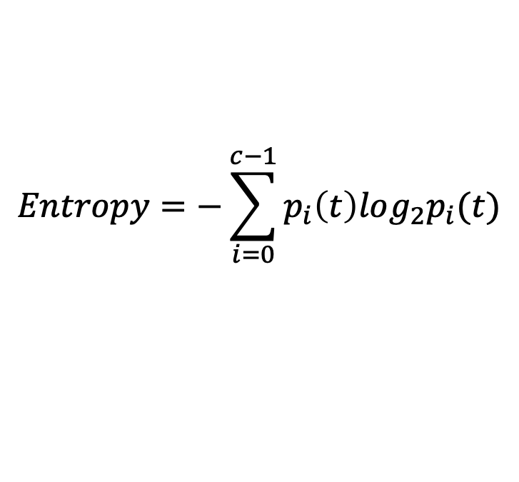
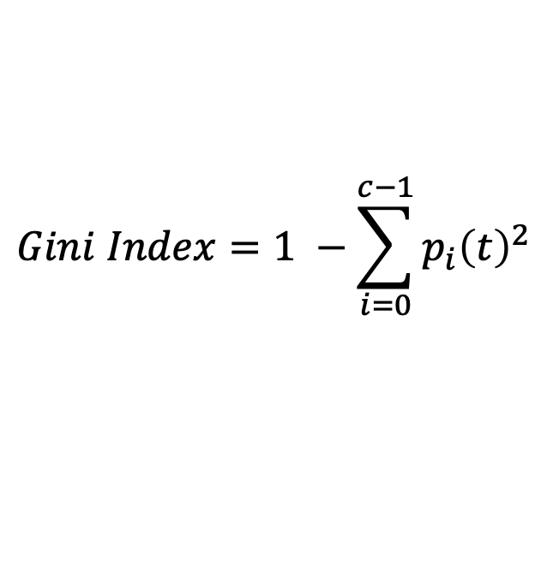
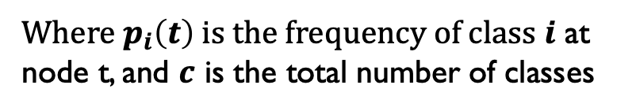
Measures of Node Impurity
Gini Index
Entropy
Misclassification error (confusing matrix for decision tree)
$$Gini Index=1 −\sum_{i=0}^{c−1}{p_{i}{\left(t\right)}^{2}}$$
Where $p_{i}\left(t\right)$ is the frequency of class $i$ at node t, and $c$ is the total number of classes
$$Entropy=−\sum_{i=0}^{c−1}{p_{i}\left(t\right)log_{2}p_{i}(t)}$$
$$Classification error={1 −max⁡[p}_{i}(t)]$$

Slide 4
Finding the Best Split
Compute impurity measure (P) before splitting
Compute impurity measure (M) after splitting
Compute impurity measure of each child node
M is the weighted impurity of child nodes
Choose the attribute test condition that produces the highest gain
Gain = P - M or equivalently, lowest impurity measure after splitting (M)

Slide 5
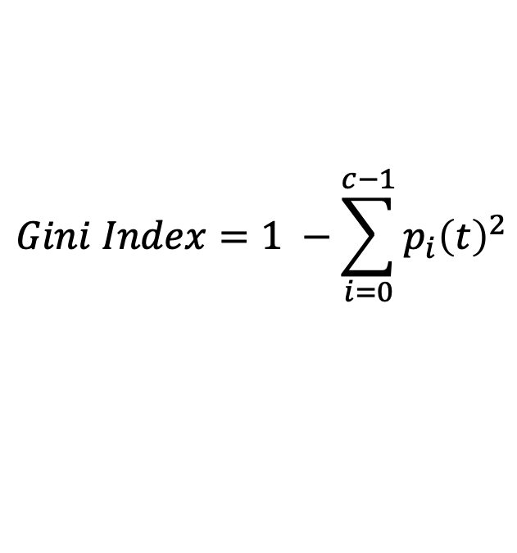
Gini Index
What is Gini Index?
Gini index or Gini impurity measures the degree or probability of a particular variable being wrongly classified when it is randomly chosen.
But what is actually meant by ‘impurity’?
If all the elements belong to a single class, then it can be called pure.
The degree of Gini index varies between 0 and 1, 0: all elements belong to a certain class or if there exists only one class, and 1: the elements are randomly distributed across various classes.
A Gini Index of 0.5 denotes equally distributed elements into some classes.
$$Gini Index=1 −\sum_{i=0}^{c−1}{p_{i}{\left(t\right)}^{2}}$$

Slide 6
Example of Gini Index
Goal: calculate the Gini index for feature / attribute “past trend”
Step1: find the values of this features (positive, negative)
Step2: For each value of this feature, we look at the corresponding labels and calculate the GI for this value.
P(up|postive) = 4/6; p(down|positive) = 2/6
p(up|negavite) = 0/4; p(down|negative) = 4/4;
GI ( past trend = positive) = 1 – [ (4/6)^2 + (2/6)^2] = 0.45
GI (past trend = negative) = 1 – [ (0)^2 +1^2] = 0
GI ( past trend) = p(postive) * GI(positive) + p(negative) *GI(negative)
=( 6/10)*0.45 + (4/10) * 0 = 0.27

Slide 7

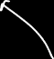
Example of Gini Index
Goal: calculate the GI for the attribute / feature: open interest
Find all the values of OI (
For each value (L or H), we look at all the labels of each values.
3. Calculate the GI for each value

Slide 8
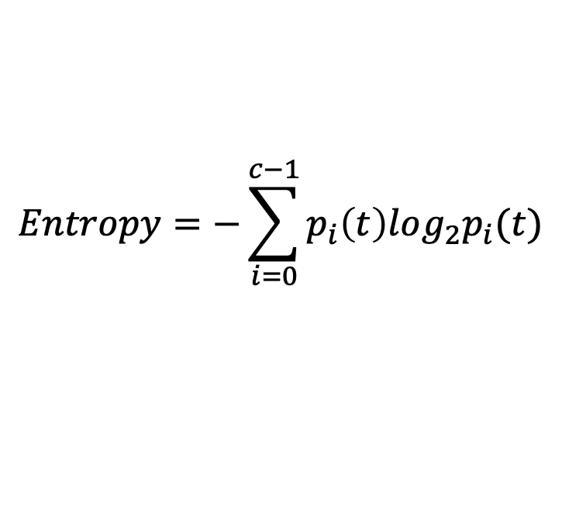
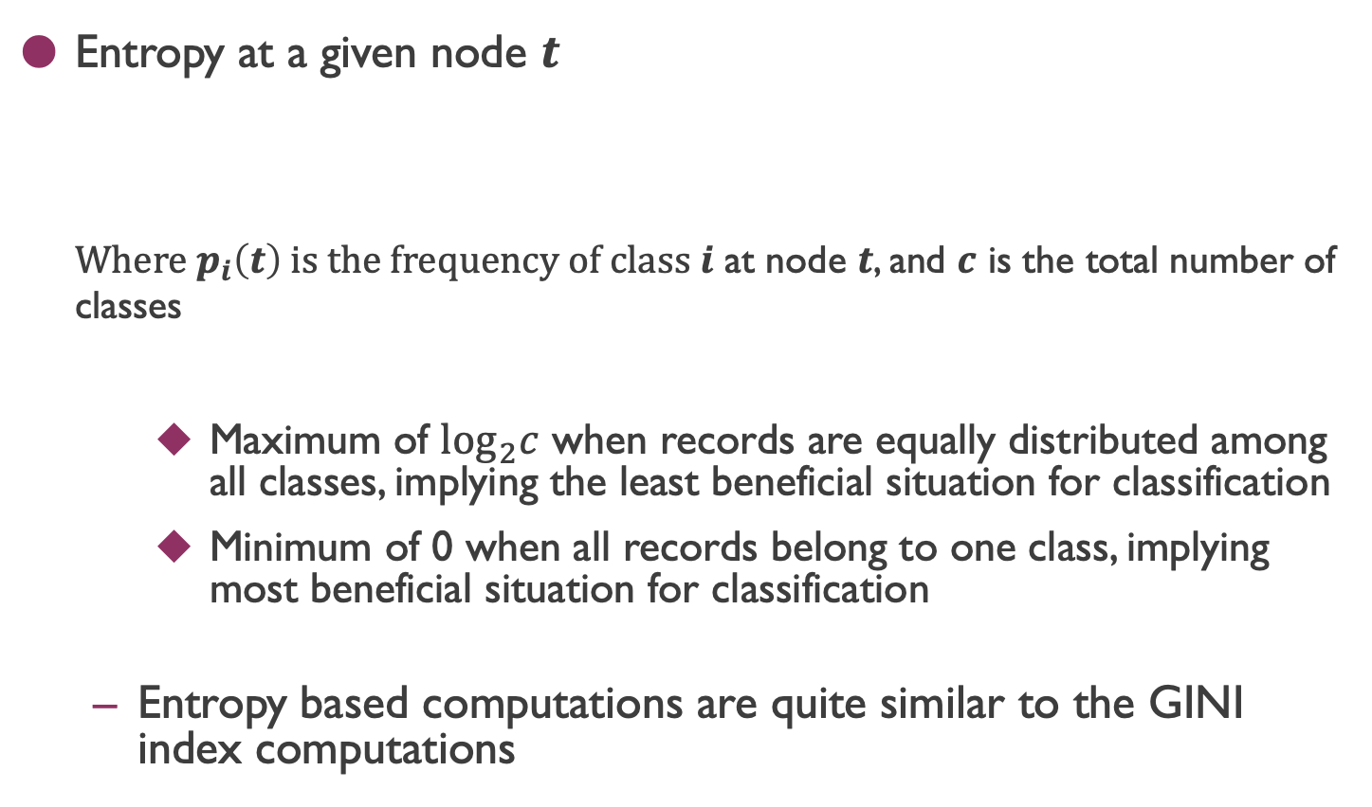
Measure of Impurity: Entropy
Entropy at a given node $t$
Where $p_{i}\left(t\right)$ is the frequency of class $i$ at node $t$, and $c$ is the total number of classes
Maximum of $\log_{2}c$ when records are equally distributed among all classes, implying the least beneficial situation for classification
Minimum of 0 when all records belong to one class, implying most beneficial situation for classification
Entropy based computations are quite similar to the GINI index computations
$$Entropy=−\sum_{i=0}^{c−1}{p_{i}\left(t\right)log_{2}p_{i}(t)}$$

Slide 9
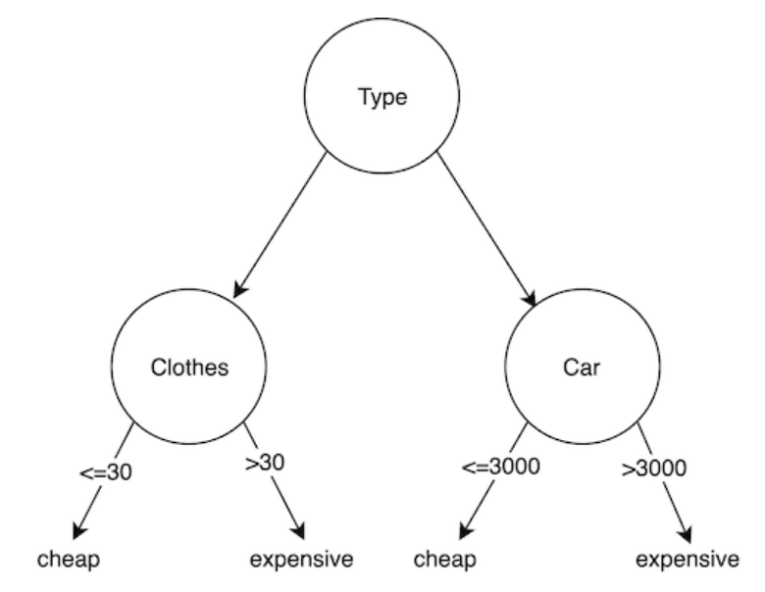
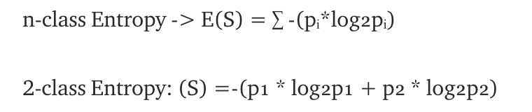
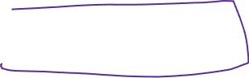
Entropy
Entropy known as the controller for decision tree to decide where to split the data.

Slide 10


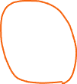
Entropy
Sample Count | Sample Label
9 | A
5 | B
$$S=−\{ p_{a} ×\log_{2}{p_{a}} +p_{b} ×\log_{2}{p_{b}}\}$$

Slide 11
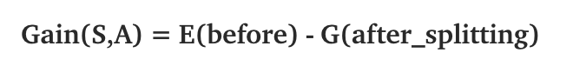
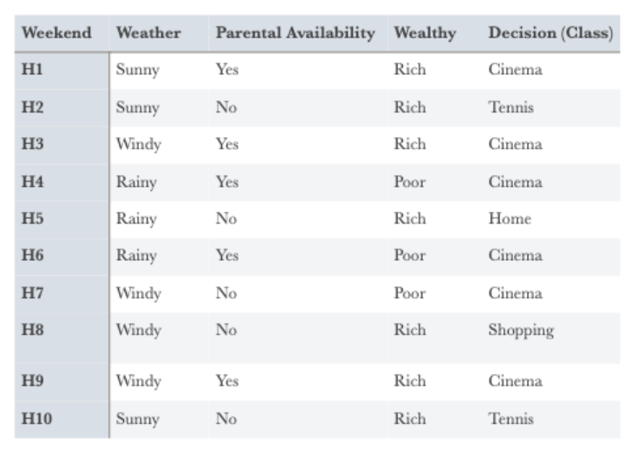
Information Gain
E(S): calculate the entropy for the dataset based on the labels
E(attribute)

Slide 12







Information Gain
Goal: (1). Calculate the entropy for the dataset
How many labels do you have ( more than two)

Slide 13


Information Gain
Goal: (1). Calculate the entropy for the dataset
How many labels do you have ( more than two)

Slide 14
Information Gain
Goal: (1). Calculate the entropy for the dataset
How many labels do you have ( more than two)
Calculate the entropy of each value for one attribute

Slide 15
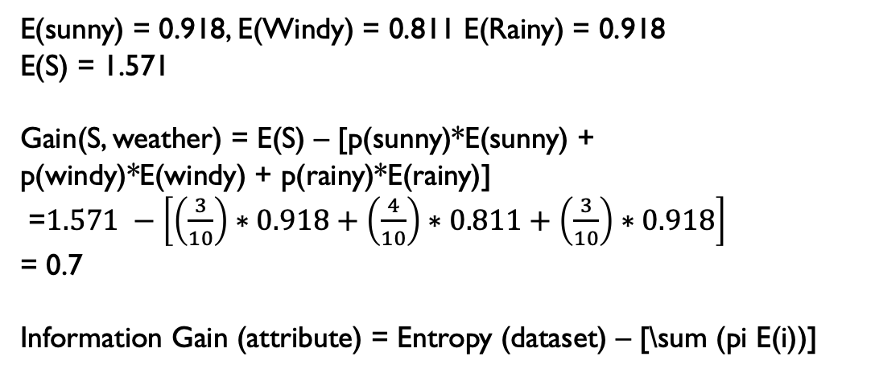
Information Gain
Goal: (1). Calculate the entropy for the dataset
How many labels do you have ( more than two)
Calculate the entropy of each value for one attribute
E(sunny) = 0.918, E(Windy) = 0.811 E(Rainy) = 0.918
E(S) = 1.571
Gain(S, weather) = E(S) – [p(sunny)*E(sunny) +
p(windy)*E(windy) + p(rainy)*E(rainy)]
=$1.571 −\left[\left(\frac{3}{10}\right)∗0.918+\left(\frac{4}{10}\right)∗0.811+\left(\frac{3}{10}\right)∗0.918\right]$
= 0.7
Information Gain (attribute) = Entropy (dataset) – [\sum (pi E(i))]

Slide 16

Information Gain
E(S) = 1.571
Gain(S, Wealthy) = E(S) – [\sum pi*E(i)]
1. What are the values of this attribute (R, P)
E[rich] = \sum pj*log_2 (pj)
=

Slide 17
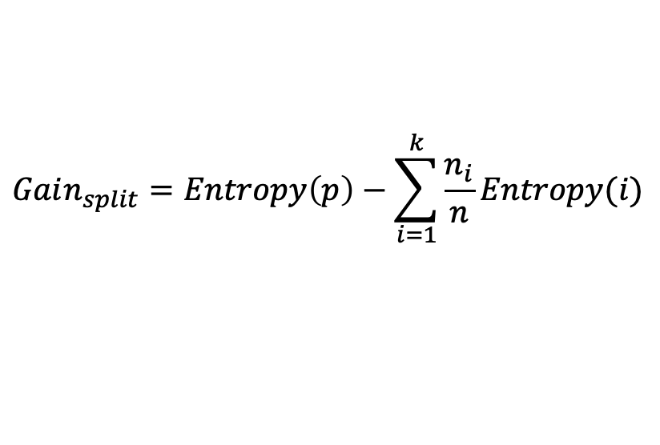
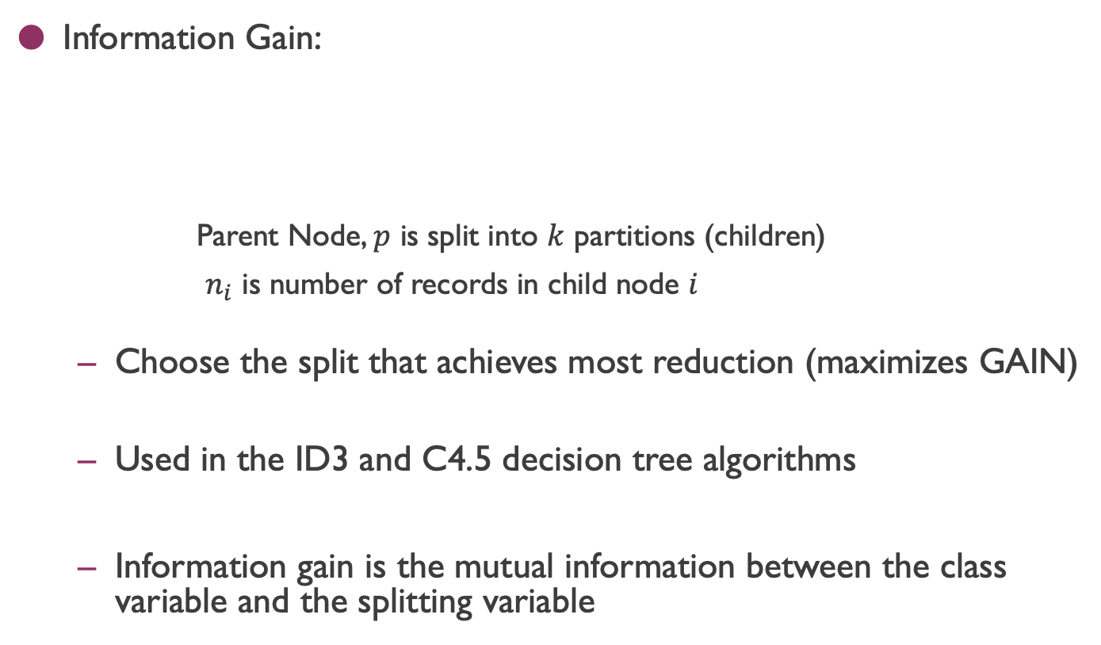
Computing Information Gain After Splitting
Information Gain:
Parent Node, $p$ is split into $k$ partitions (children)
$n_{i}$ is number of records in child node $i$
Choose the split that achieves most reduction (maximizes GAIN)
Used in the ID3 and C4.5 decision tree algorithms
Information gain is the mutual information between the class variable and the splitting variable
$$Gain_{split}=Entropy\left(p\right)−\sum_{i=1}^{k}{\frac{n_{i}}{n}Entropy(i)}$$

Slide 18
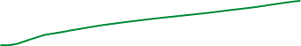


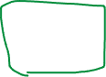
Problem with large number of partitions
Node impurity measures tend to prefer splits that result in large number of partitions, each being small but pure
Customer ID has highest information gain because entropy for all the children is zero

Slide 19
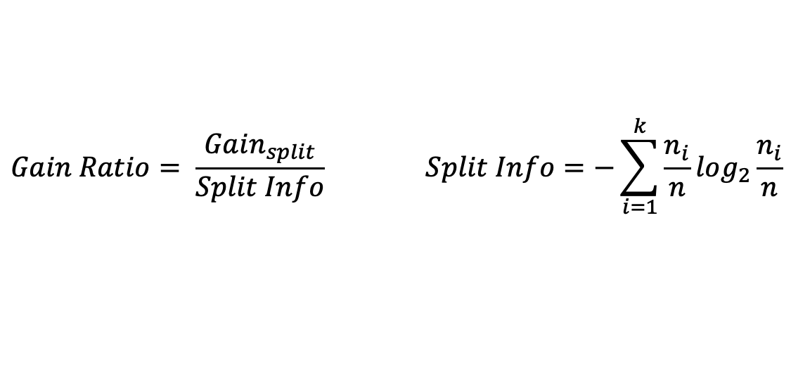
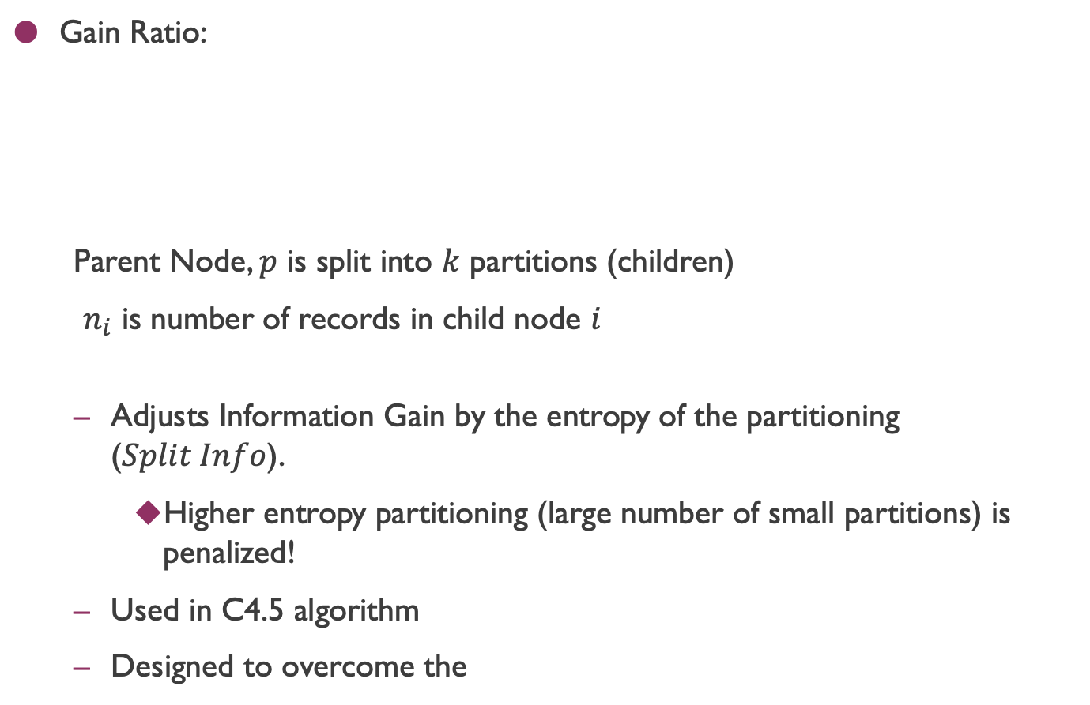
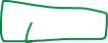
Gain Ratio
Gain Ratio:
Parent Node, $p$ is split into $k$ partitions (children)
$n_{i}$ is number of records in child node $i$
Adjusts Information Gain by the entropy of the partitioning ($Split Info$).
Higher entropy partitioning (large number of small partitions) is penalized!
Used in C4.5 algorithm
Designed to overcome the
$$Gain Ratio= \frac{Gain_{split}}{Split Info} Split Info=−\sum_{i=1}^{k}{\frac{n_{i}}{n}log_{2}}\frac{n_{i}}{n}$$

Slide 20
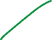
Measures of Node Impurity
Gini Index
Entropy
Misclassification error (confusing matrix for decision tree)
$$Gini Index=1 −\sum_{i=0}^{c−1}{p_{i}{\left(t\right)}^{2}}$$
Where $p_{i}\left(t\right)$ is the frequency of class $i$ at node t, and $c$ is the total number of classes
$$Entropy=−\sum_{i=0}^{c−1}{p_{i}\left(t\right)log_{2}p_{i}(t)}$$
$$Classification error={1 −max⁡[p}_{i}(t)]$$

Slide 21
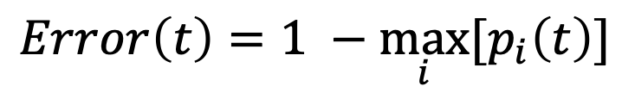
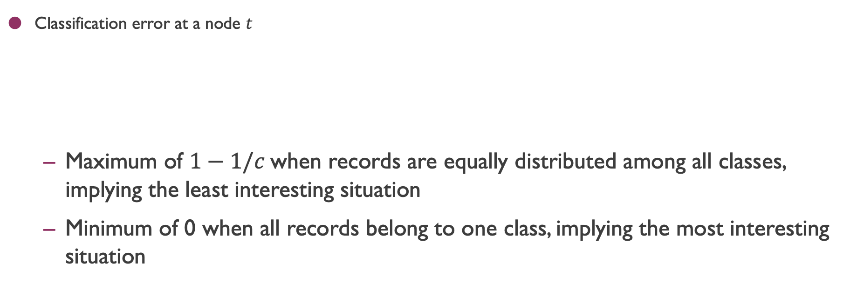
Measure of Impurity: Classification Error
Classification error at a node $t$
Maximum of $1−1/c$when records are equally distributed among all classes, implying the least interesting situation
Minimum of 0 when all records belong to one class, implying the most interesting situation
$$Error\left(t\right)=\underset{ i}{1 −max}⁡[p_{i}\left(t\right)]$$

Slide 22
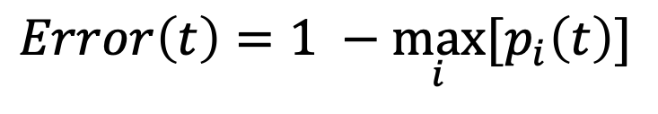
Computing Error of a Single Node
$$Error\left(t\right)=\underset{ i}{1 −max}⁡[p_{i}\left(t\right)]$$
P(C1) = 0/6 = 0 P(C2) = 6/6 = 1
Error = 1 – max (0, 1) = 1 – 1 = 0
Error = 1 – max(probabilities for all labels)
= 1- max ( 0/6, 6/6 ) = 1-1 = 0
P(C1) = 1/6 P(C2) = 5/6
Error = 1 – max (1/6, 5/6) = 1 – 5/6 = 1/6
Error = 1 – max (probability of all the labels)
= 1 – max ( 2/6, 4/6 ) = 1 – 4/6 = 2/6 = 1/3 = 0.333

Slide 23
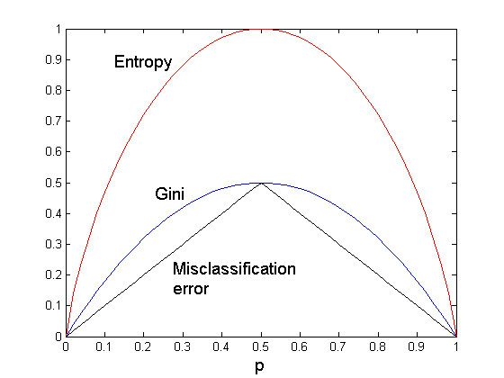
Comparison among Impurity Measures
For a 2-class problem:

Slide 24




Misclassification Error vs Gini Index
A?
Yes
No
Node N1
Node N2
Gini(N1) = 1 – (3/3)² – (0/3)² = 0
Gini(N2) = 1 – (4/7)² – (3/7)² = 0.489
Gini(Children) = 3/10 * 0 + 7/10 * 0.489 = 0.342
Gini improves but error remains the same.
Error = 1- max(7/10, 3/10) = 3/10

Slide 25
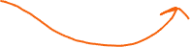

Misclassification Error vs Gini Index
A?
Yes
No
Node N1
Node N2
Misclassification error for all three cases = 0.3 !

Slide 26
Decision Tree Based Classification
Advantages:
Relatively inexpensive to construct
Extremely fast at classifying unknown records
Easy to interpret for small-sized trees
Robust to noise (especially when methods to avoid overfitting are employed)
Can easily handle redundant attributes
Can easily handle irrelevant attributes (unless the attributes are interacting)
Disadvantages: .
Due to the greedy nature of splitting criterion, interacting attributes (that can distinguish between classes together but not individually) may be passed over in favor of other attributed that are less discriminating.
Each decision boundary involves only a single attribute

Slide 27
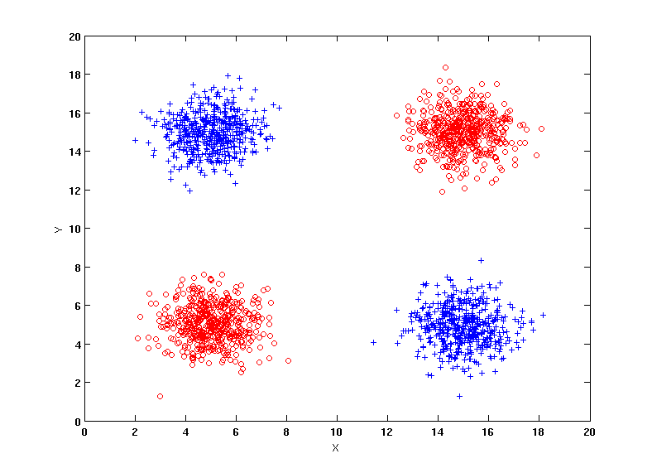
Handling interactions
+ : 1000 instances
o : 1000 instances
Entropy (X) : 0.99
Entropy (Y) : 0.99
Y
X

Slide 28
Handling interactions

Slide 29
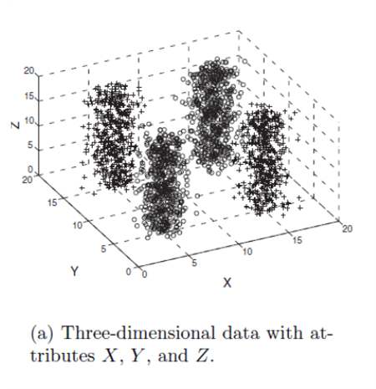
Handling interactions given irrelevant attributes
Y
+ : 1000 instances
o : 1000 instances
Adding Z as a noisy attribute generated from a uniform distribution
Entropy (X) : 0.99
Entropy (Y) : 0.99
Entropy (Z) : 0.98
Attribute Z will be chosen for splitting!
X

Slide 30
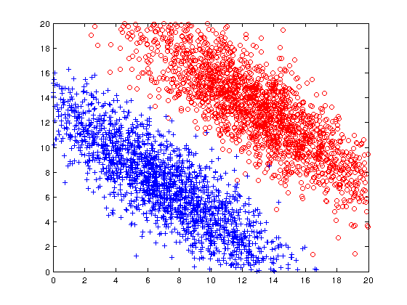
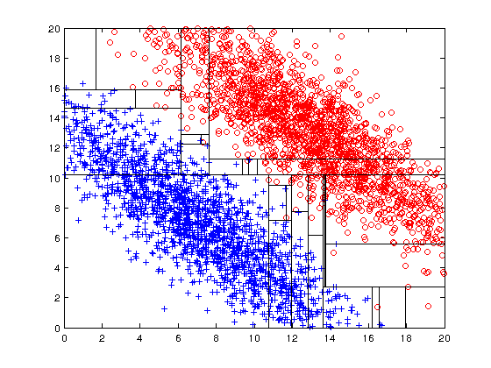
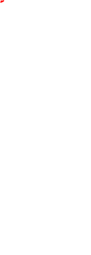
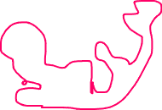
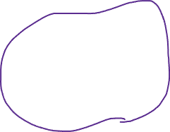
Limitations of single attribute-based decision boundaries
Both positive (+) and negative (o) classes generated from skewed Gaussians with centers at (8,8) and (12,12) respectively.

Slide 31


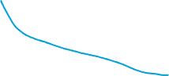

Classification Errors
Training errors: Errors committed on the training set
Test errors: Errors committed on the test set
Generalization errors:
Expected error of a model over random selection of records from same distribution

Slide 32
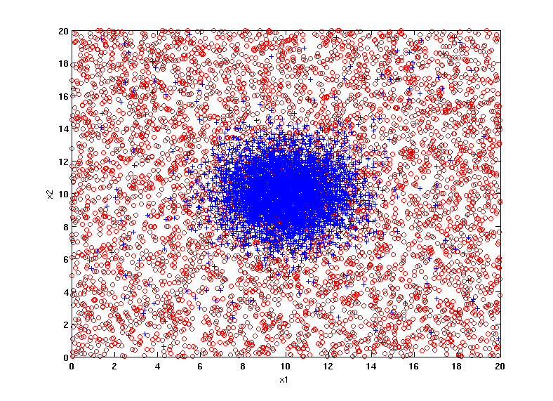
Example Data Set
Two class problem:
+ : 5400 instances
5000 instances generated from a Gaussian centered at (10,10)
400 noisy instances added
o : 5400 instances
Generated from a uniform distribution
10 % of the data used for training and 90% of the data used for testing

Slide 33
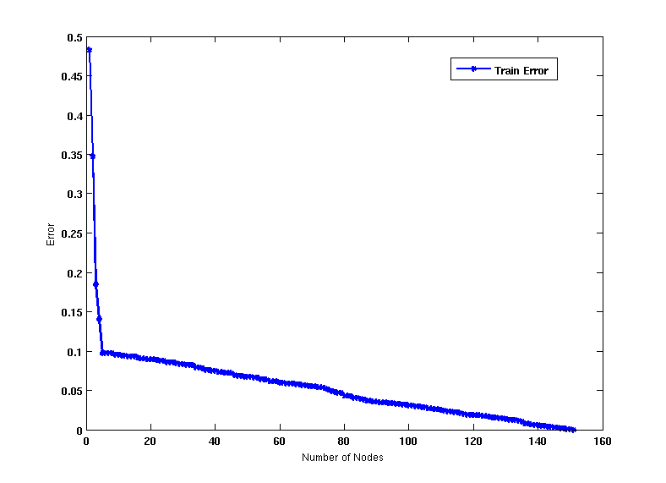
Increasing number of nodes in Decision Trees

Slide 34
Decision Tree with 4 nodes
Decision Tree
Decision boundaries on Training data

Slide 35
Decision Tree with 50 nodes
Decision Tree
Decision Tree
Decision boundaries on Training data

Slide 36
Which tree is better?
Decision Tree with 4 nodes
Which tree is better ?
Decision Tree with 50 nodes

Slide 37
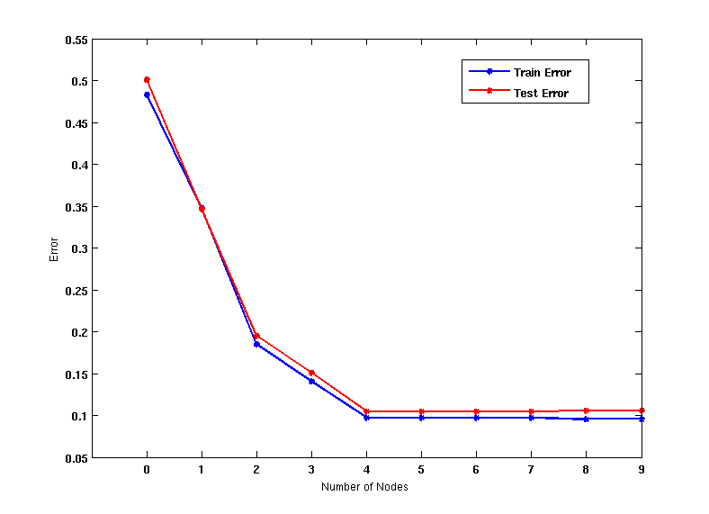
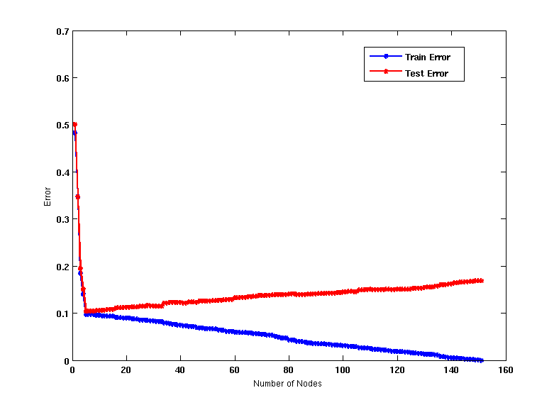
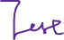
Model Underfitting and Overfitting
As the model becomes more and more complex, test errors can start increasing even though training error may be decreasing
Underfitting: when model is too simple, both training and test errors are large
Overfitting: when model is too complex, training error is small but test error is large

Slide 38
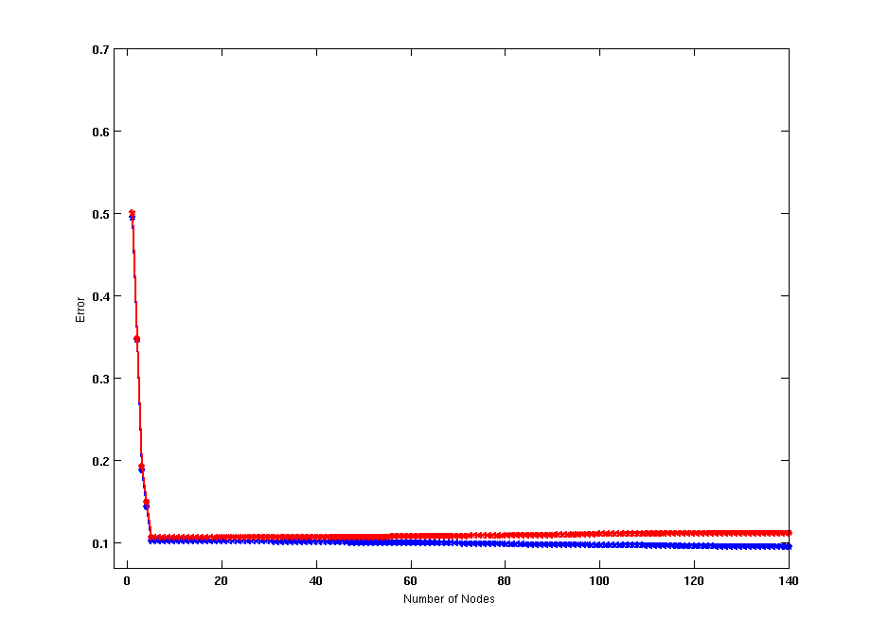
Model Overfitting – Impact of Training Data Size
Using twice the number of data instances
Increasing the size of training data reduces the difference between training and testing errors at a given size of model

Slide 39
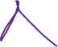
Model Overfitting – Impact of Training Data Size
Decision Tree with 50 nodes
Decision Tree with 50 nodes
Using twice the number of data instances
Increasing the size of training data reduces the difference between training and testing errors at a given size of model

Slide 40
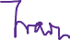

Reasons for Model Overfitting
Not enough training data
High model complexity
Multiple Comparison Procedure

Slide 41
Effect of Multiple Comparison Procedure
Consider the task of predicting whether stock market will rise/fall in the next 10 trading days
Random guessing:
P(correct) = 0.5
Make 10 random guesses in a row:
Day 1 | Up
Day 2 | Down
Day 3 | Down
Day 4 | Up
Day 5 | Down
Day 6 | Down
Day 7 | Up
Day 8 | Up
Day 9 | Up
Day 10 | Down

Slide 42
Effect of Multiple Comparison Procedure
Approach:
Get 50 analysts
Each analyst makes 10 random guesses
Choose the analyst that makes the most number of correct predictions
Probability that at least one analyst makes at least 8 correct predictions
P(at leaset one person making at least 8 correct prediction )
=1 – p(all of them making less than 8 correct prediction )
= 1 – (p(one person making less than 8 correct prediction)) ^50
= 1 – (1-(0.0547))^50

Slide 43
Effect of Multiple Comparison Procedure
Many algorithms employ the following greedy strategy:
Initial model: M
Alternative model: M’ = M ∪ γ, where γ is a component to be added to the model (e.g., a test condition of a decision tree)
Keep M’ if improvement, Δ(M,M’) > α
Often times, γ is chosen from a set of alternative components, Γ = {γ₁, γ₂, …, γ_{k}}
If many alternatives are available, one may inadvertently add irrelevant components to the model, resulting in model overfitting

Slide 44
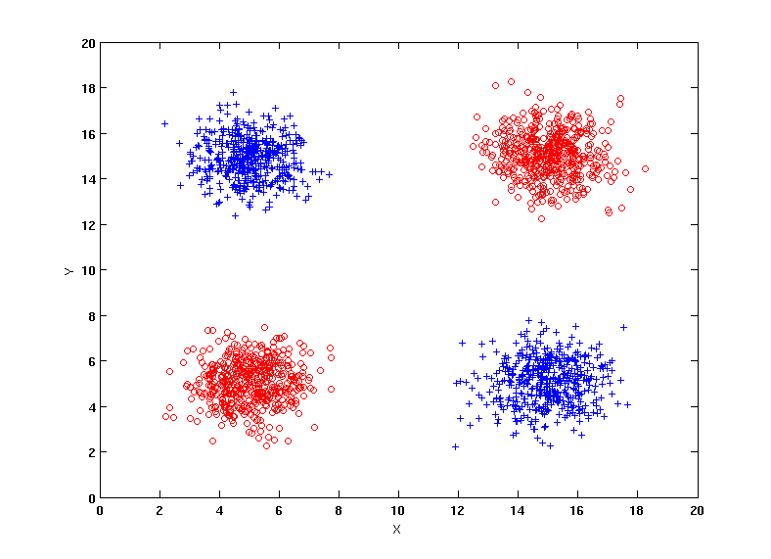
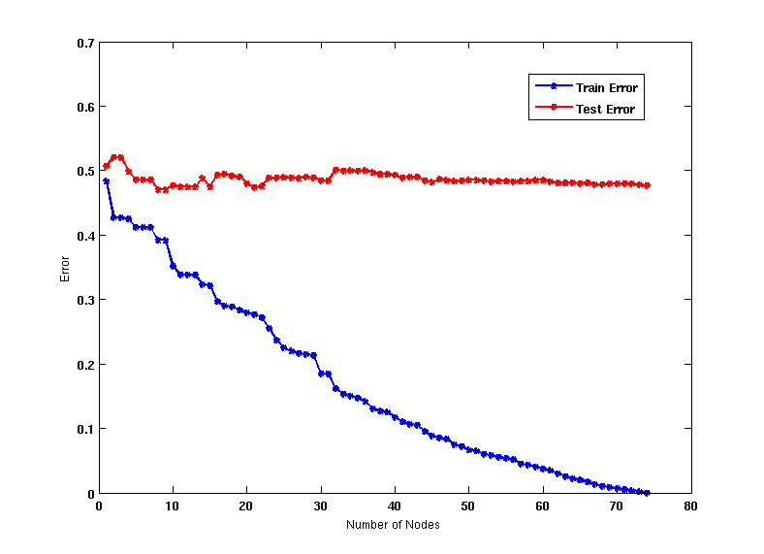
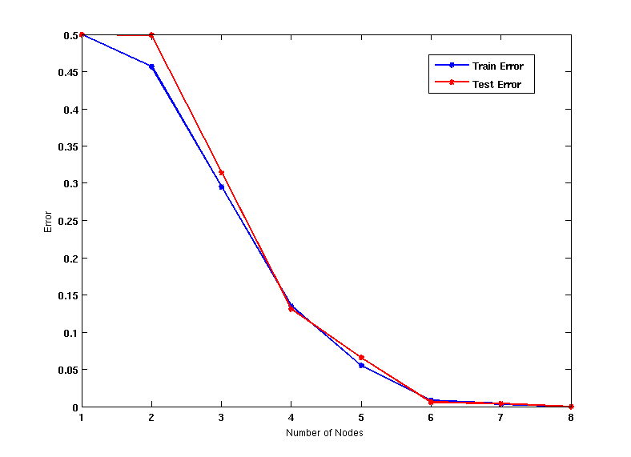
Effect of Multiple Comparison - Example
Use additional 100 noisy variables generated from a uniform distribution along with X and Y as attributes.
Use 30% of the data for training and 70% of the data for testing
Using only X and Y as attributes

Slide 45
Notes on Overfitting
Overfitting results in decision trees that are more complex than necessary
Training error does not provide a good estimate of how well the tree will perform on previously unseen records
Need ways for estimating generalization errors

